Slide 1
Capacity: Making a summer fruit drink

Slide 2
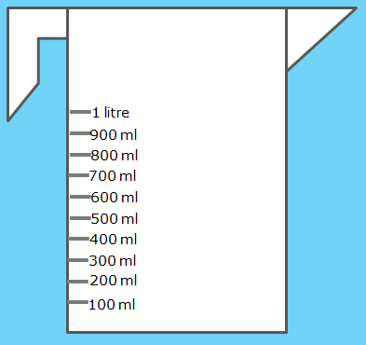
You will need: 200 ml cranberry juice
Which measuring jug has the correct amount of cranberry juice?

Slide 3
Sorry, you picked 300ml
Try Again

Slide 4
Well done!
Next question

Slide 5
You will need: 100 ml pineapple juice
Which measuring jug has the correct amount of pineapple juice?

Slide 6
Sorry, you picked 200ml
Try Again

Slide 7
Well done!
Next question

Slide 8
You will need: 400 ml sparkling water
Which measuring jug has the correct amount of sparkling water?

Slide 9
Sorry, you picked 200ml
Try Again

Slide 10
Well done!
Next task

Slide 11
Why not follow the instructions or design your own summer fruit drink?

