Slide 1
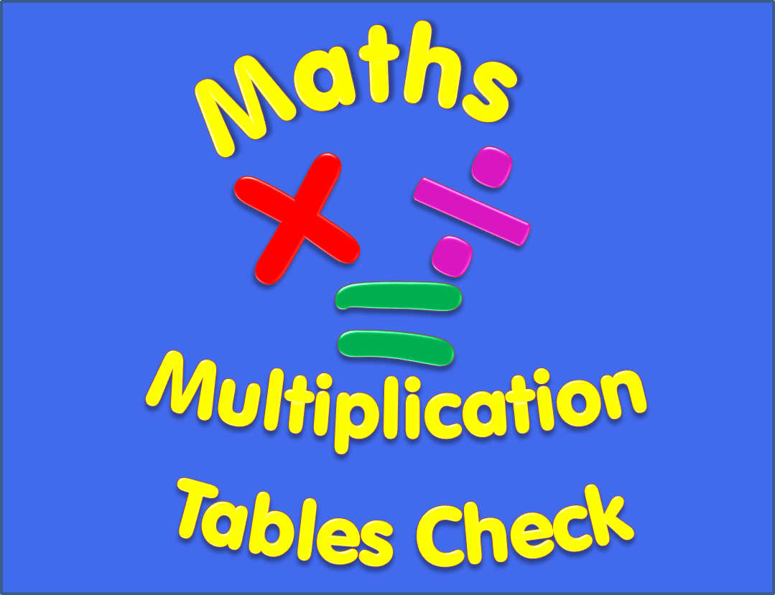

Slide 2
Begin
Instructions
There are 25 multiplication questions on any times table from 2 to 12.
Each multiplication question will appear on the screen for 6 seconds. There will then be a 3 second break before the next question appears.
Good Luck!

Slide 3
3 x 2
Q1

Slide 4
12 x 3
Q2

Slide 5
10 x 9
Q3

Slide 6
6 x 8
Q4

Slide 7
6 x 9
Q5

Slide 8
6 x 4
Q6

Slide 9
4 x 5
Q7

Slide 10
4 x 7
Q8

Slide 11
8 x 12
Q9

Slide 12
9 x 3
Q10

Slide 13
7 x 3
Q11

Slide 14
7 x 8
Q12

Slide 15
9 x 9
Q13

Slide 16
10 x 11
Q14

Slide 17
7 x 5
Q15

Slide 18
12 x 12
Q16

Slide 19
12 x 11
Q17

Slide 20
5 x 8
Q18

Slide 21
8 x 8
Q19

Slide 22
11 x 7
Q20

Slide 23
11 x 8
Q21

Slide 24
2 x 12
Q22

Slide 25
9 x 8
Q23

Slide 26
7 x 6
Q24

Slide 27
2 x 6
Q25

Slide 28
Completed!
All multiplication questions have now been shown.
To find out your score click on the button below.
Answers

Slide 29
Answers
1) 3 x 2 = 6 2) 12 x 3 = 36 3) 10 x 9 = 90
4) 6 x 8 = 4 5) 6 x 9 = 54 6) 6 x 4 = 24
7) 4 x 5 = 20 8) 4 x 7 = 28 9) 8 x 12 = 96
10) 9 x 3 = 27 11) 7 x 3 = 21 12) 7 x 8 = 56
13) 9 x 9 = 81 14) 10 x 11 = 110 15) 7 x 5 = 35
16) 12 x 12 = 144 17) 12 x 11 = 132 18) 5 x 8 = 40
19) 8 x 8 = 64 20) 11 x 7 = 77 21) 11 x 8 = 88
22) 2 x 12 = 24 23) 9 x 8 = 72 24) 7 x 6 = 42
25) 2 x 6 = 12

